Slide 1

Design Pattern
Search
Singleton
Truong Dang Minh Khue

Slide 2
Definition
We use it when want to create exactly one Object for the program.
Singleton Pattern

Slide 3
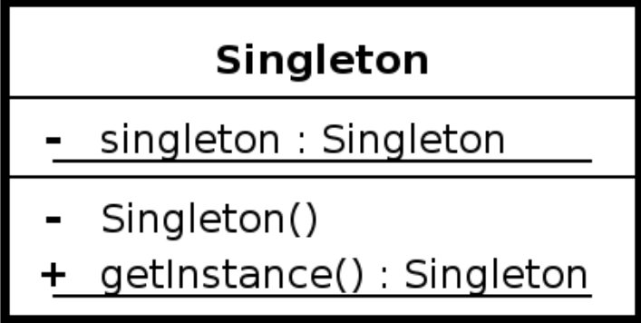

Slide 4


 | Singleton Applications
1
2
3
4
Hardware interface access | Logger | Configuration file | Caching

Slide 5

Thank you!
Until our next design pattern!

